Slide 1
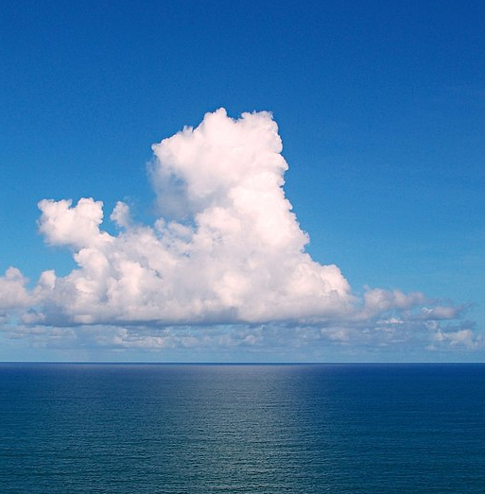

Scale-dependence in the response of the tropical MABL to SST variability:
A numerical study and
Future perspectives
Presenter: Alessandro Storer

Slide 2
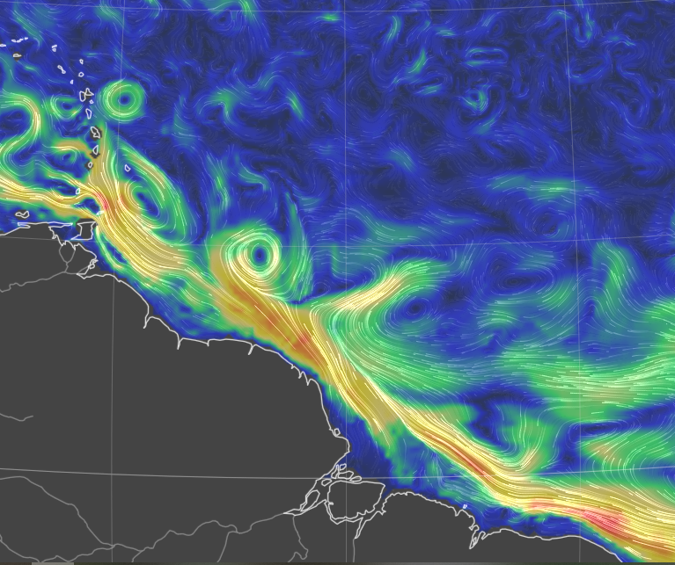
The Sub - / Mesoscale – an introduction
Important in the global energy budget!
(Renault et al. 2023, Seo et al. 2023,
Bishop et al. 2020)
Thermal feedback TFB
Modulates local temperature, stability and circulation through modified thermodynamic fluxes
10N
NUMERICAL DATASETS
- Conceptual bulk model for PBL
High-resolution coupled simulation:
WRF 2km atmosphere
CROCO 1km ocean
Daily averages in February 2020
EUREC4A region Stevens et al. 2021
EQ
60W
50W
40W
Sea sfc currents on 6 th April 2025
earth.null.school
Notes:
Check minobe’s and chelton’s, fabien’s articles for summarizing image

Slide 3
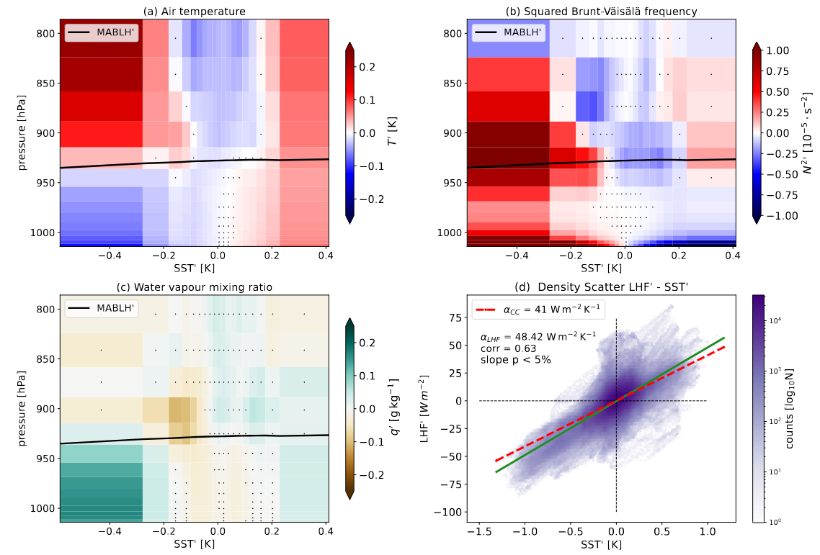
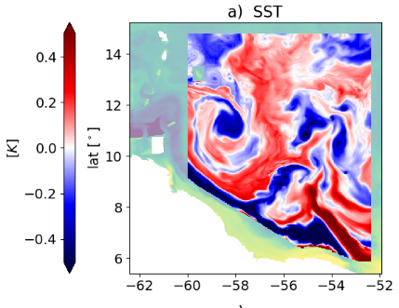
Previous episodes recap
a) Fully-coupled simulation
Fixed scale of interest < ~150km
→ correlate SST’ with atmosphere

Slide 4

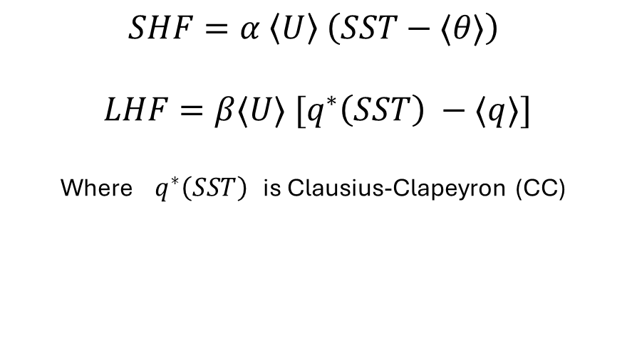
Sensitivity of surface fluxes to SST
MABL
$$SHF=α \left\langle U\right\rangle \left(SST−⟨θ⟩\right)$$
$$LHF=β⟨U⟩ [q^{∗}\left(SST\right) −⟨q⟩]$$
Where $q^{∗}\left(SST\right)$ is Clausius-Clapeyron (CC)
SHF’ ?
LHF’ ?
SHF’ ?
LHF’ ?
$$sensitivities == \frac{∂HF′}{∂SST′}$$
SST’ < 0
SST’ > 0
Notes:
Check how WRF is computing surface fluxes in the coupled simulation

Slide 5
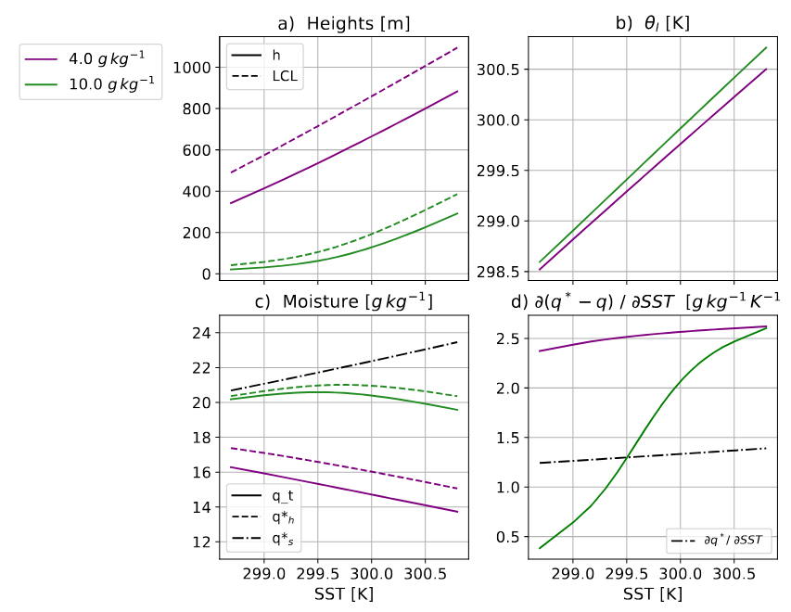
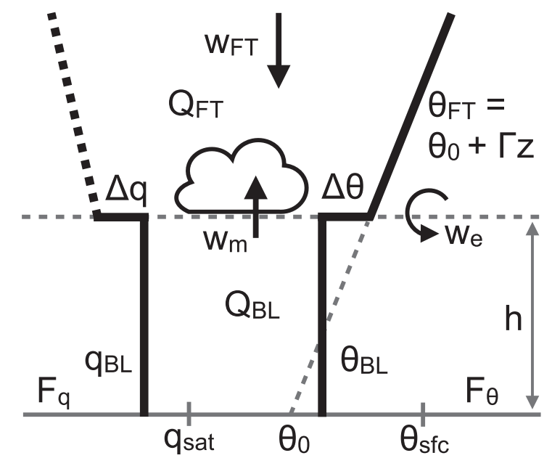
A minimal physics approach
Conceptual Bulk model
starring:
Stevens et al. 2002
Neggers et al. 2006
Naumann et al. 2019

Slide 6



A minimal physics approach
What is the range of validity of this 1D bulk model ?
How does the thermodynamic adjustment change with scales?

Slide 7
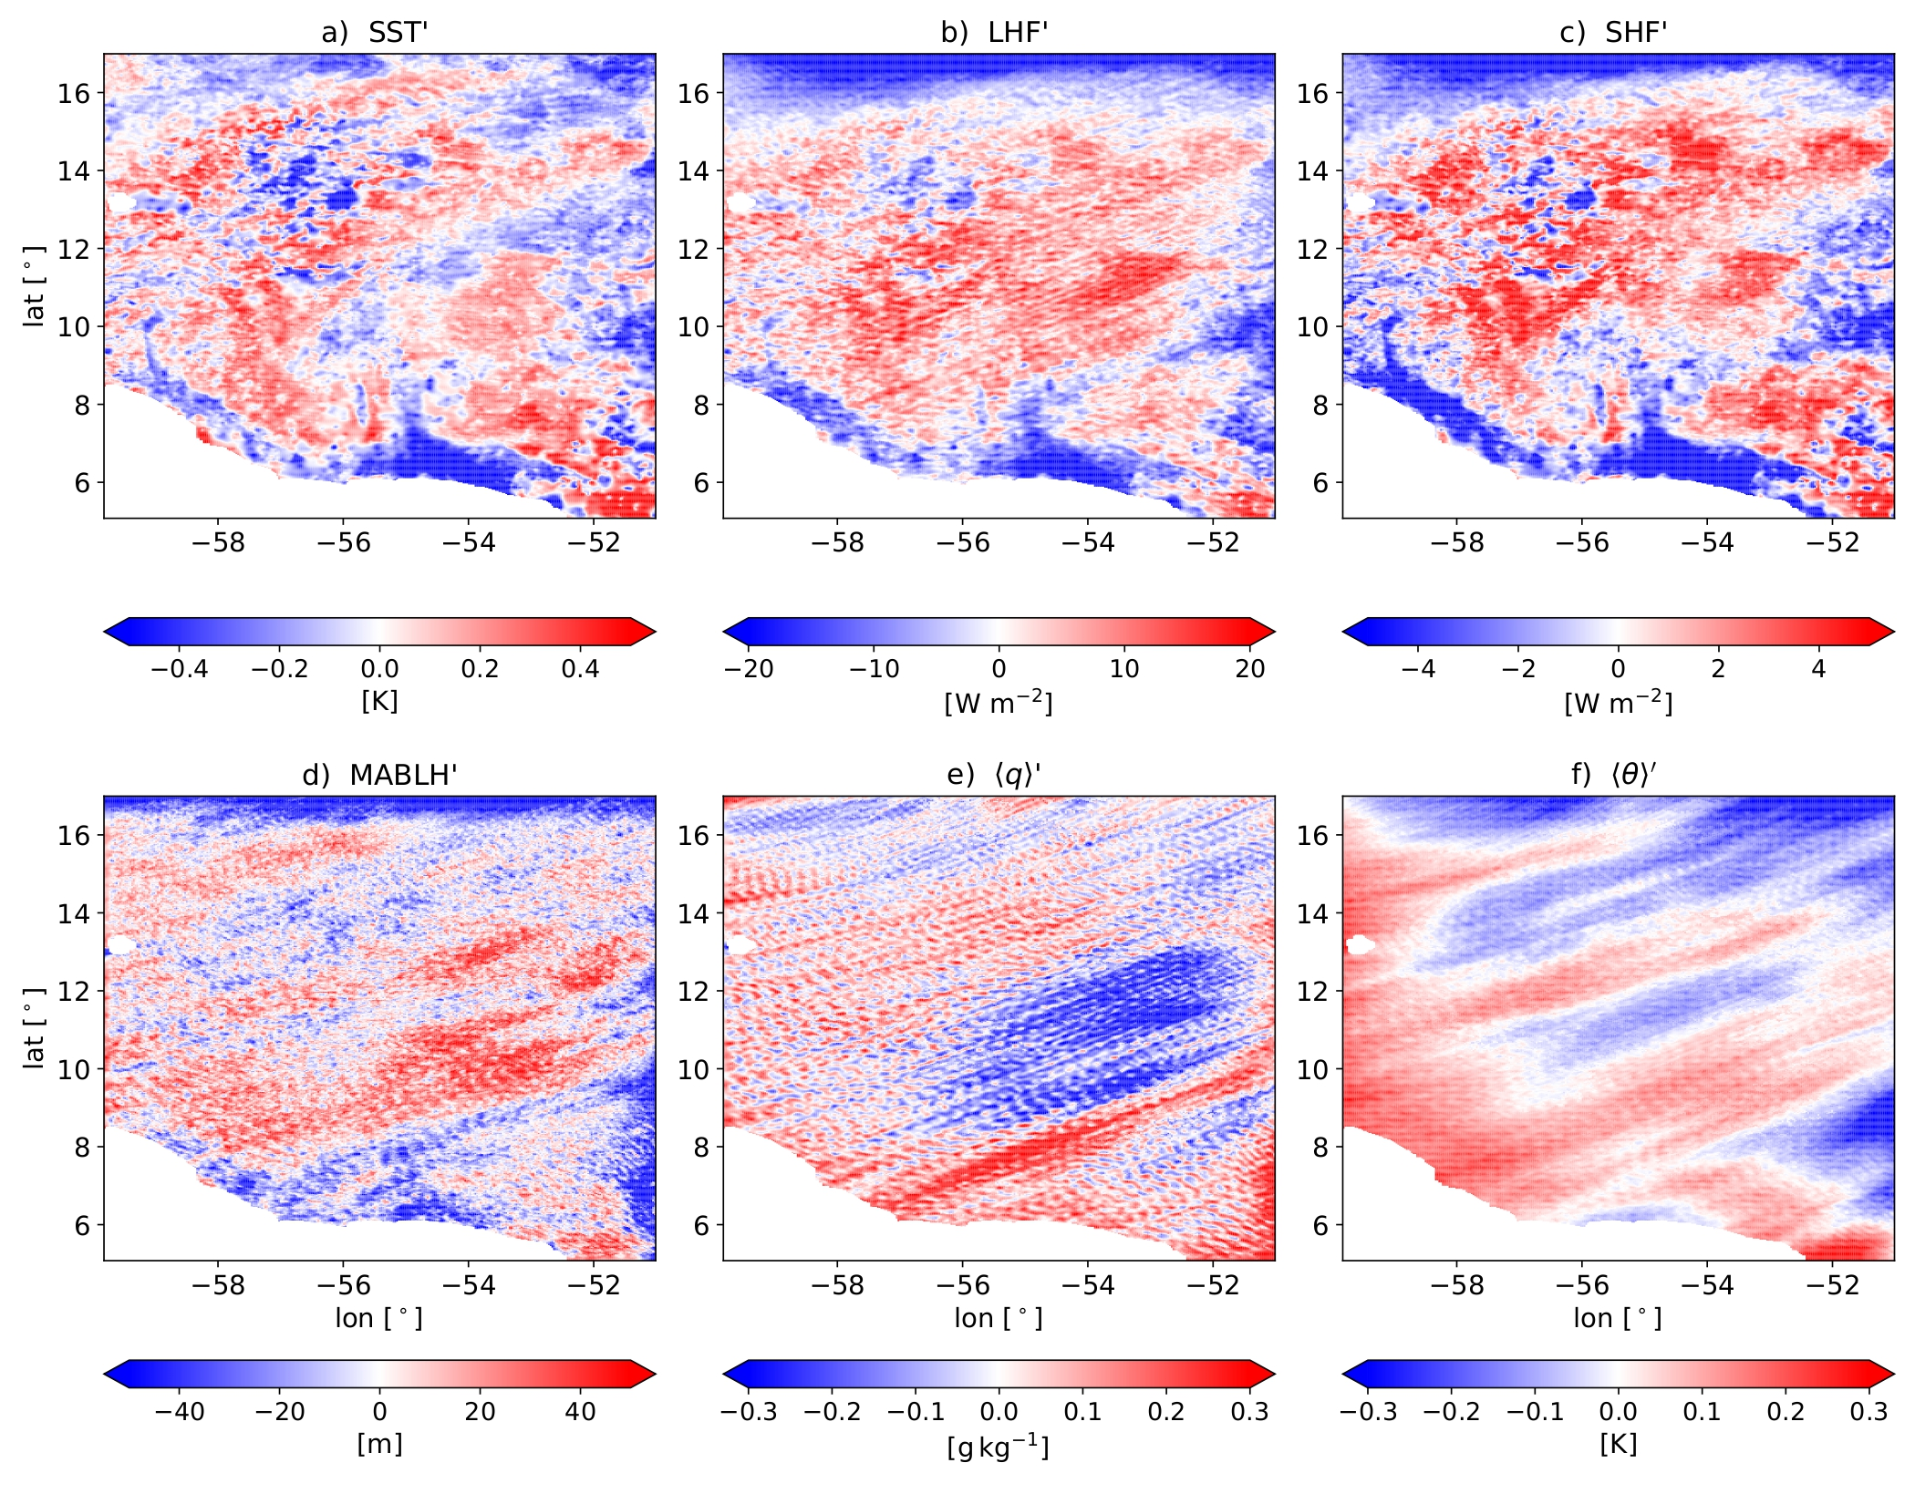
A different realistic simulation
High-resolution simulation:
WRF 2km atmosphere
SST daily forcing MUR-L4
Daily averages in February 2020
EUREC4A region Stevens et al. 2021

Slide 8
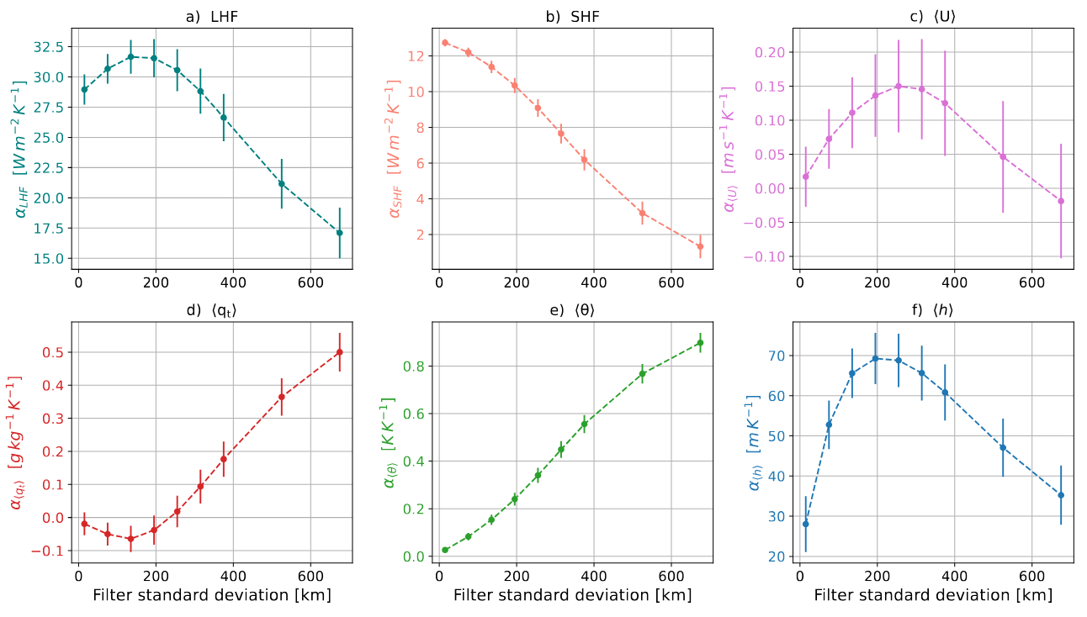
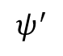
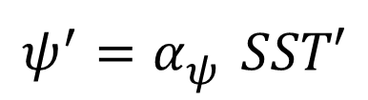
Scale-dependent coupling
$$ψ^{′}=α_{ψ}^{} SST′$$
$$ψ^{′}$$
SST’

Slide 9
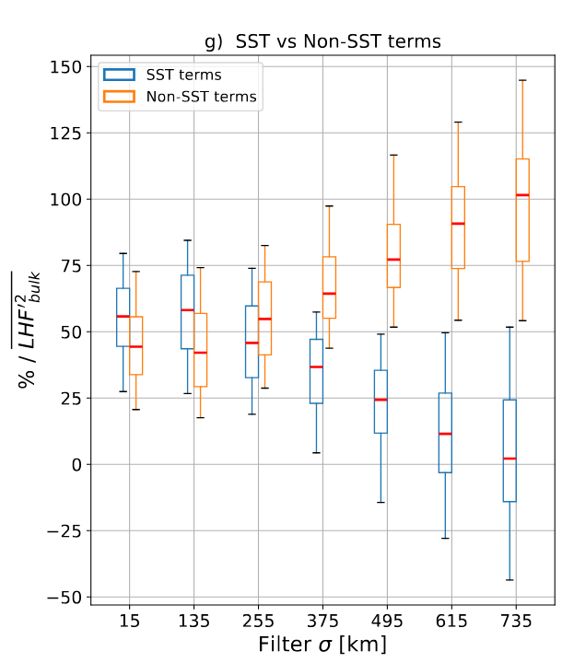
What sets the variability of energy exchanges?

Slide 10
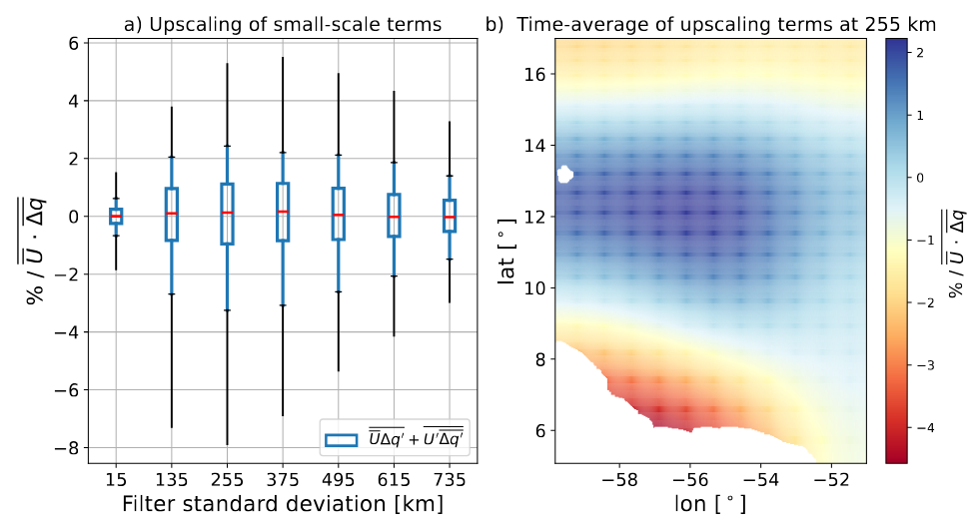
Upscaling effect

Slide 11
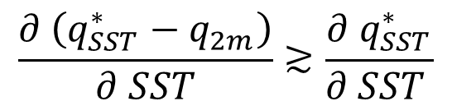
Conclusions
MABL – SST coupling is scale-dependent
Primary mechanism for
thermodynamic adjustment
over daily means
MABLH’
Feedback on surface LHF
$$\frac{∂ \left(q_{SST}^{∗}−q_{2m}\right)}{∂ SST}≳\frac{∂{ q}_{SST}^{∗}}{∂ SST }$$
Small-scale SST variability
dominates LHF variance
and excites non-linear upscaling effects
SST’ < 0
SST’ > 0

Slide 12
Now, from this …

Slide 13
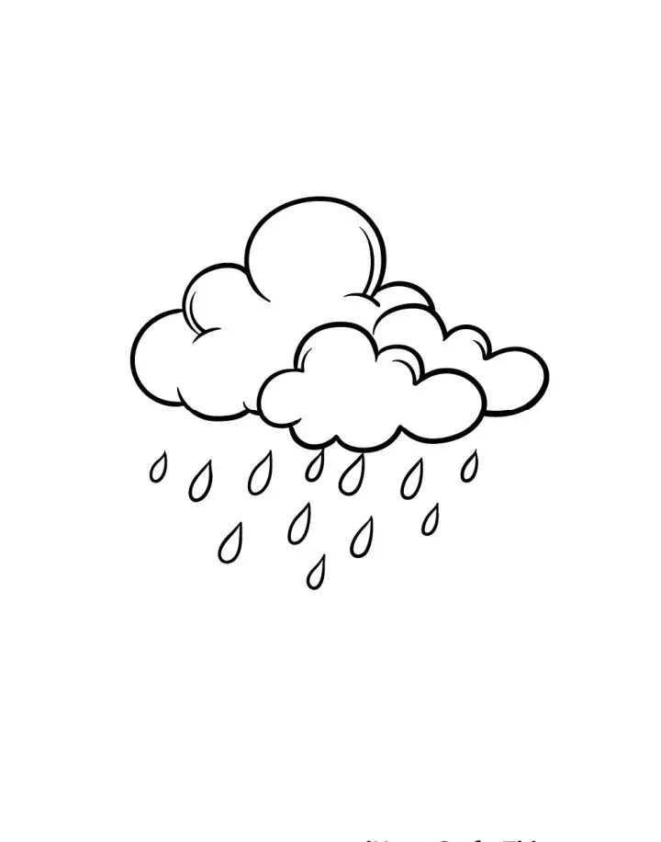
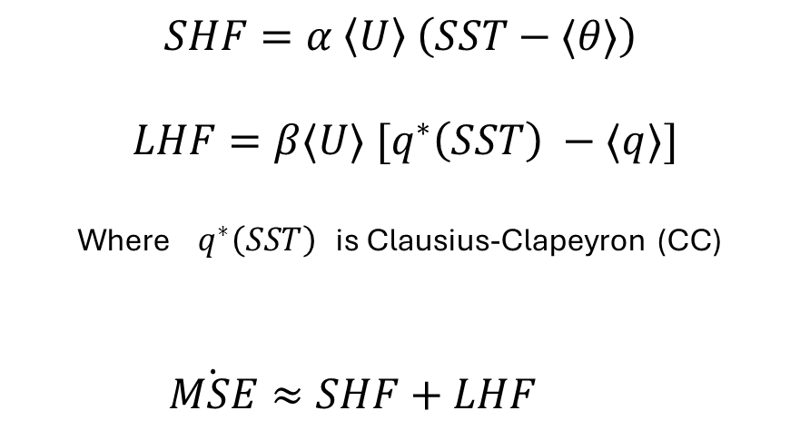
Role of surface fluxes and downdrafts?
$$SHF=α \left\langle U\right\rangle \left(SST−⟨θ⟩\right)$$
$$LHF=β⟨U⟩ [q^{∗}\left(SST\right) −⟨q⟩]$$
Where $q^{∗}\left(SST\right)$ is Clausius-Clapeyron (CC)
$\dot{MSE}≈SHF+LHF$
MABL
SHF
LHF
BOUNDARY-LAYER
QUASI-EQUILIBRIUM
The warm sea of the Warm Pool
MSE
Notes:
Check how WRF is computing surface fluxes in the coupled simulation

Slide 14
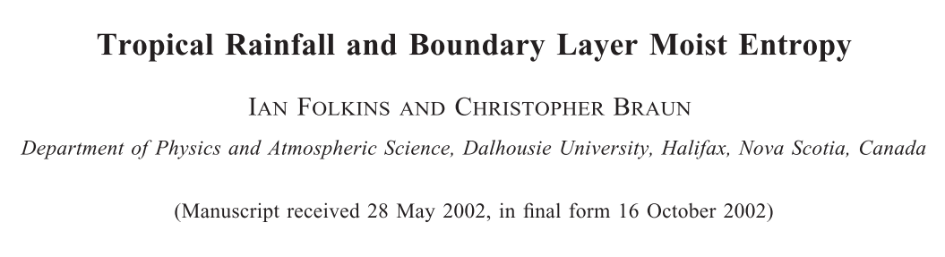
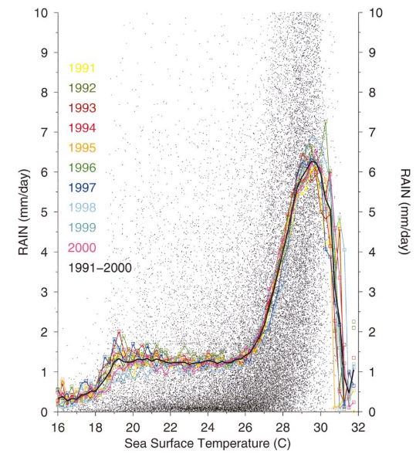
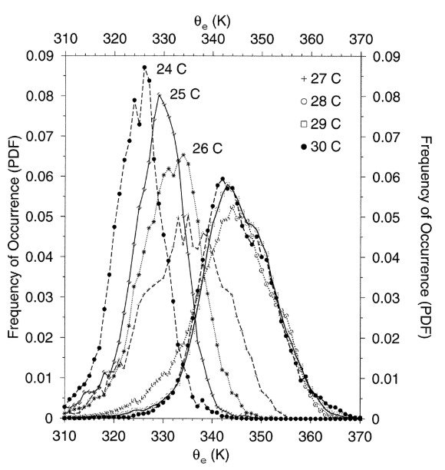

Slide 15
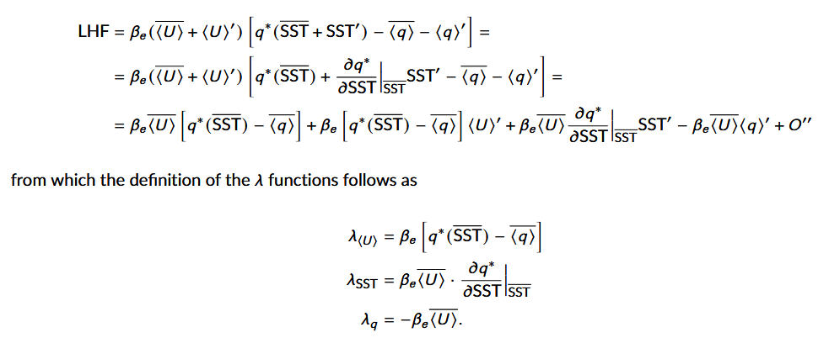
Backup

